Slide 1
Introduction to Structural Member Properties
Principles of Engineering
© 2012 Project Lead The Way, Inc.

Slide 2
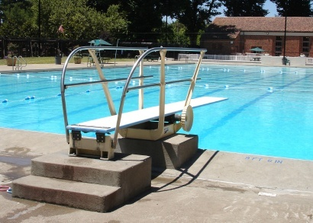
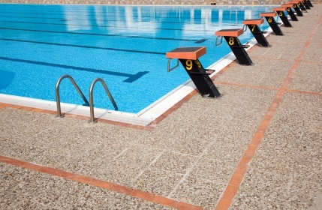
Structural Member Properties
Moment of Inertia (I) is a mathematical property of a cross section (measured in inches⁴) that gives important information about how that cross-sectional area is distributed about a centroidal axis.
Stiffness of an object related to its shape
In general, a higher moment of inertia produces a greater resistance to deformation.
©iStockphoto.com
©iStockphoto.com

Slide 3
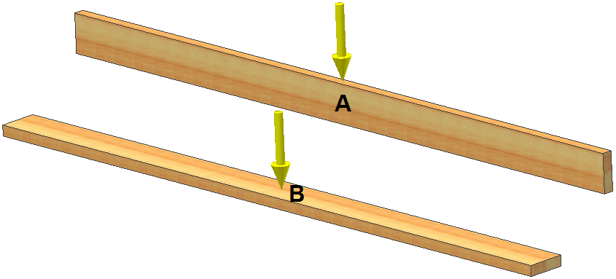
Moment of Inertia Principles
Joist
Plank
Beam | Material | Length | Width | Height | Area
A | Douglas Fir | 8 ft | 1 ½ in. | 5 ½ in. | 8 ¼ in.²
B | Douglas Fir | 8 ft | 5 ½ in. | 1 ½ in. | 8 ¼ in.²
Notes:
Compare these two beams.

Slide 4
Moment of Inertia Principles
What distinguishes beam A from beam B?
Will beam A or beam B have a greater resistance to bending, resulting in the least amount of deformation, if an identical load is applied to both beams at the same location?

Slide 5

Calculating Moment of Inertia – Rectangles
Moment of Inertia Principles
Why did beam B have greater deformation than beam A?
Difference in moment of inertia due to the orientation of the beam
h

Slide 6
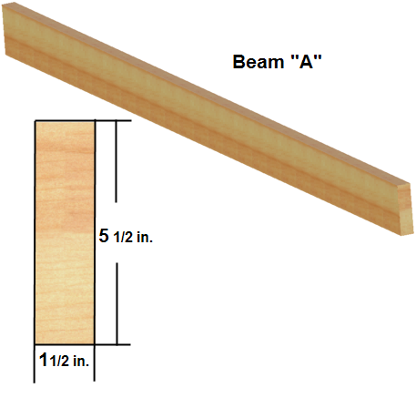
Calculating Moment of Inertia
Calculate beam A moment of inertia

Slide 7
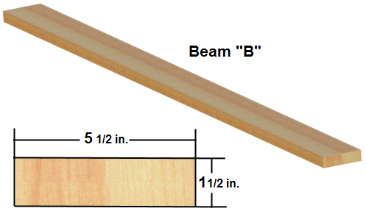
Calculating Moment of Inertia
Calculate beam B moment of inertia

Slide 8
Moment of Inertia
14Times Stiffer
Beam A
Beam B

Slide 9
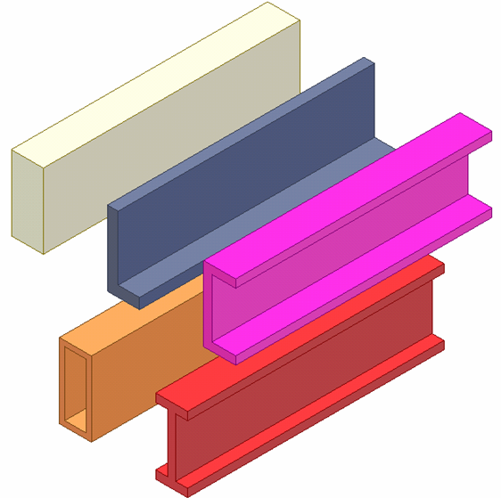
Moment of Inertia – Composite Shapes
Why are composite shapes used in structural design?
Notes:
A composite shape is a shape that consists of two or more geometric shapes.

Slide 10
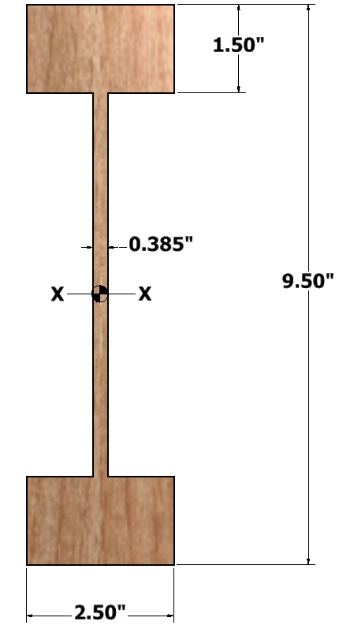
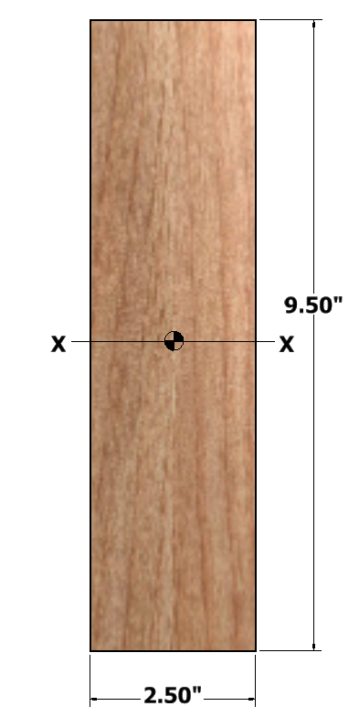
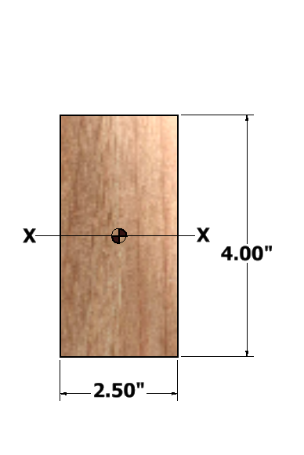
Non-Composite vs. Composite Beams
Doing more with less
Area = 10.0 in.²
Area = 10.0 in.²
Area = 23.8 in.²
I_{xx} = 13.3 in.⁴
I_{xx} = 130 in.⁴
I_{xx} = 178 in.⁴
Notes:
Let us compare the moment of inertia of three joists with the given shapes. [click]. Wood I-beams (rather than dimensional lumber) are commonly used for joist in wood framed structures. The wood I-beams are constructed using dimensional lumber for the top and bottom flanges and a plywood web.
Calculate the area for each of the cross sections. [click]
Calculate the moment of inertia for each of the rectangular cross sections. [click]
Calculating the moment of inertia for a composite shape, such as an I-beam, is beyond the scope of this presentation; however, the value is given for purposes of comparison. [click] They are many online applications that will calculate the moment of inertia for I-beams.
Note that the moment of inertia is a section property and depends on the shape of the member. The type of material from which the member is made does not affect the moment of inertia.
Why do you think that I-beams are used rather than rectangular sections? What is the advantage to using wood I-beams rather than dimensional lumber alone? Note that the first two cross sections have the same cross sectional area but the I-beam provides a moment of inertia nearly 10 times larger. The I-beam provides a stiffer beam resulting in much less deflection compared to the rectangular beam of the same cross section.
Also note that a rectangular joist with the same overall height and width as the I-beam has more than double the cross sectional area and therefore the mass will be more than doubled. However, the rectangular section with equivalent OVERALL dimensions provides only a modest increase in the moment of inertia. What is the percent increase in the moment of inertia? [% increase = (178-130)/130 X 100% = 37% increase]

Slide 11


Structural Member Properties
Chemical Makeup
Modulus of Elasticity (E) The ratio of the increment of some specified form of stress to the increment of some specified form of strain. Also known as coefficient of elasticity, elasticity modulus, elastic modulus. This defines the stiffness of an object related to material chemical properties.
In general, a higher modulus of elasticity produces a greater resistance to deformation.

Slide 12
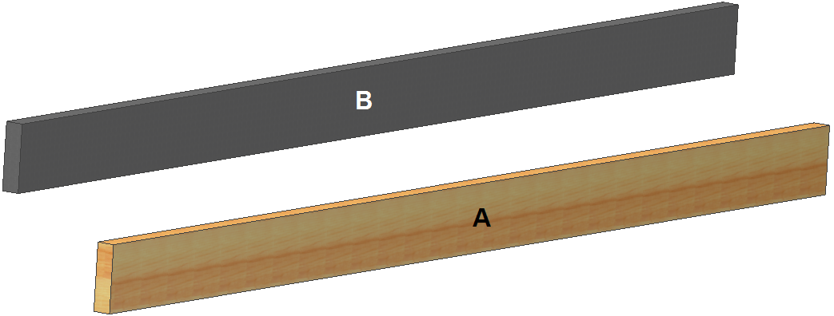
Modulus of Elasticity Principles
Beam | Material | Length | Width | Height | Area | I
A | Douglas Fir | 8 ft | 1 ½ in. | 5 ½ in. | 8 ¼ in.² | 20.8 in.⁴
B | ABS plastic | 8 ft | 1 ½ in. | 5 ½ in. | 8 ¼ in.² | 20.8 in.⁴
Notes:
Note that the cross sectional shape and dimensions are the same for Beam A and Beam B.

Slide 13
Modulus of Elasticity Principles
What distinguishes beam A from beam B?
Will beam A or beam B have a greater resistance to bending, resulting in the least amount of deformation, if an identical load is applied to both beams at the same location?

Slide 14
Modulus of Elasticity Principles
Why did beam B have greater deformation than beam A?
Difference in material modulus of elasticity – The ability of a material to deform and return to its original shape
Characteristics of objects that affect deflection (Δ_{MAX})
Applied force or load
Length of span between supports
Modulus of elasticity
Moment of inertia
Notes:
It is important to note that while the moment of inertia is a section property and depends on the shape of the member (not on the material of the beam), the modulus of elasticity is a material property and depends on the material from which the beam is constructed (not the shape).

Slide 15
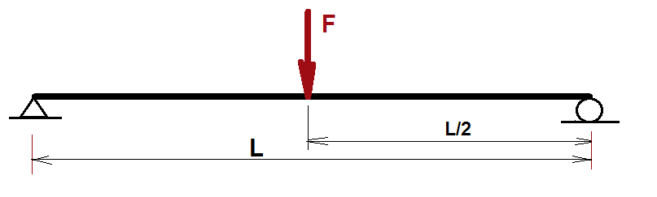
Calculating Beam Deflection
Beam | Material | Length (L) | Moment of Inertia (I) | Modulus of Elasticity (E) | Force (F)
A | Douglas Fir | 8.0 ft | 20.80 in.⁴ | 1,800,000 psi | 250 lbf
B | ABS Plastic | 8.0 ft | 20.80 in.⁴ | 419,000 psi | 250 lbf
Notes:
This is the formula for maximum beam deflection (at the center of the span) when a concentrated load is applied at the center of the span to a simply supported beam.
Based on the formula,
Describe the relationship between the maximum beam deflection and the modulus of elasticity. Are the two directly related? Inversely related? Not related? [The maximum beam deflection is inversely related to the modulus of elasticity, that is, as the modulus of elasticity increases, the maximum deflection decreases.]
Describe the relationship between the maximum beam deflection and the moment of inertia. [The maximum beam deflection is inversely related to the moment of inertia, that is, as the moment of inertia increases, the maximum deflection decreases.]
Describe the relationship between the maximum beam deflection and the span length of the beam. [The maximum beam deflection is directly related to the span length, that is, as the span length increases, the maximum deflection increases.]
Describe the relationship between the maximum beam deflection and the magnitude of the applied concentrated load. [The maximum beam deflection is directly related to the magnitude of the applied concentrated load, that is, as the magnitude of the applied load increases, the maximum deflection increases.]
Describe the relationship between the direction of the maximum deflection and the direction of the applied force (up or down). [The deflection is in the same direction as the applied force, that is, if the force is applied upward, the maximum deflection will be upward. If the force is applied downward, the deflection will be downward. Note that if the force is applied laterally (side-to-side) the moment of inertia will likely be different.]
Describe the relationship between the maximum deflection and the cross sectional area of the beam. [The maximum deflection is not related to the cross sectional area of the beam. It is not the cross sectional area but the moment of inertia that affects the stiffness of the beam.]
Explain how different cross sectional areas could result in the same moment of inertia.

Slide 16
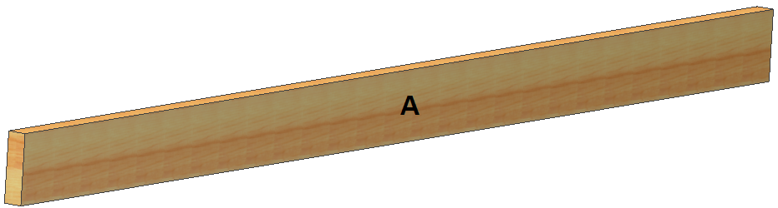
Calculating Beam Deflection
Calculate beam deflection for beam A
Beam | Material | Length | I | E | Load
A | Douglas Fir | 8.0 ft | 20.80 in.⁴ | 1,800,000 psi | 250 lbf

Slide 17
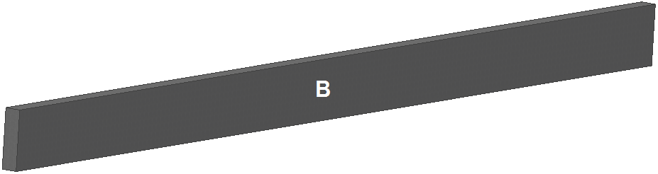
Calculating Beam Deflection
Calculate beam deflection for beam B
Beam | Material | Length | I | E | Load
B | ABS Plastic | 8.0 ft | 20.80 in.⁴ | 419,000 psi | 250 lbf

Slide 18
Douglas Fir vs. ABS Plastic
Notes:
What is the ratio of E values for the two beams? What is the ratio of deflections? Are the two ratios related?
[The maximum deflection of Beam B is approximately 4.4 times greater than the maximum deflection of Beam A (if you do not round the deflection values).
Conversely, the modulus of elasticity of Beam A is approximately 4.4 times greater than the modulus of elasticity of Beam B.]

